Slide 1
Game Idea Review
Course : Mobile and Web Game Programming
Effective Period : September 2018

Slide 2
These slides have been adapted from: Dr Penny de Byl. 2014. Holistic Mobile Game Development with Unity. FOCAL. Burlington. ISBN:978-0415839235 Chapter 1 and Fullerton, Tracy. (2008). GAME DESIGN WORKSHOP: A Playcentric Approach to Creating Innovative Games. Morgan Kaufman ISBN 978-0-240-80974-8
Acknowledgement

Slide 3
Learning Objectives
LO 1 : Apply best practices of mobile and web game development
LO 2 : Apply game design and marketing techniques to boost mobile game performance
LO 3 : Produce game in mobile and web platform
LO 4 : Design game monetization and business model

Slide 4
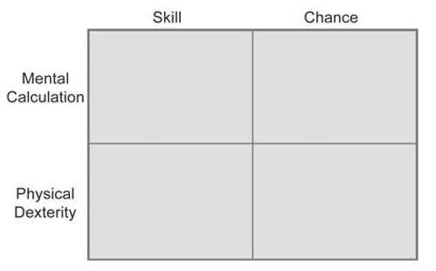
The Game Matrix

Slide 5
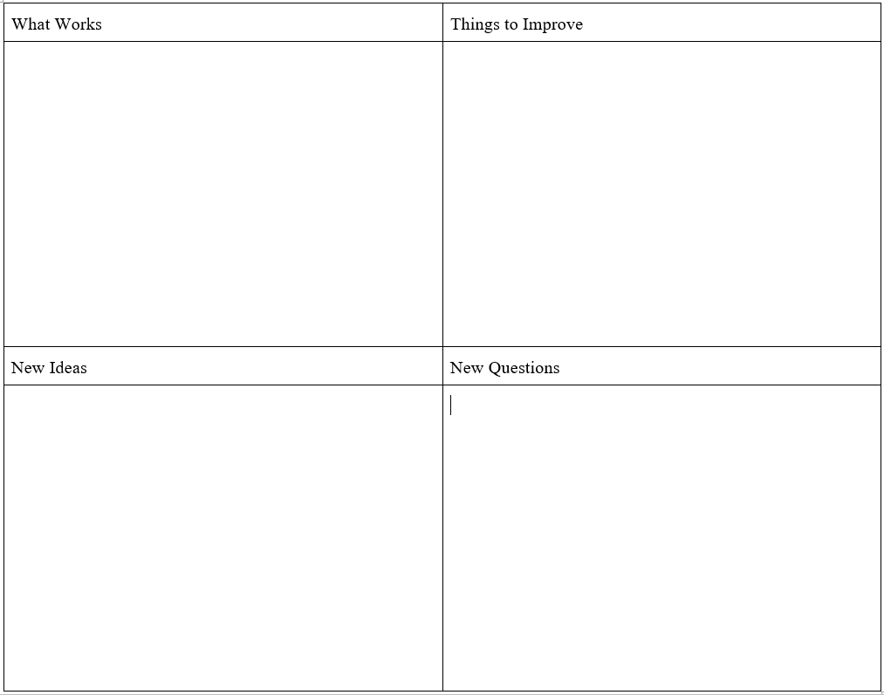
WINQ FEEDBACK

Slide 6
References
Fullerton, Tracy. (2008). GAME DESIGN WORKSHOP: A Playcentric Approach to Creating Innovative Games. Morgan Kaufman ISBN 978-0-240-80974-8

